Slide 1
TNE20002 / TNE70003
Topic 7 NAT V1.0

Slide 2
NAT
Network
Address
Translation
2
Notes:
2

Slide 3
Network Address Translation
NAT (defined by RFC 1631) is designed to conserve IP addresses and enable networks to use private IP addresses on internal networks.
These private IP addresses are translated to routable public IP addresses for accessing the Internet.
NAT translations can occur dynamically or statically.
NAT (PAT) port address translation allows multiple private ip addresses to map to the same public ip address.
3
Notes:
3

Slide 4
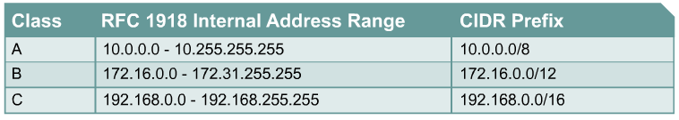
Private addressing – Internal Networks
4
Notes:
4

Slide 5
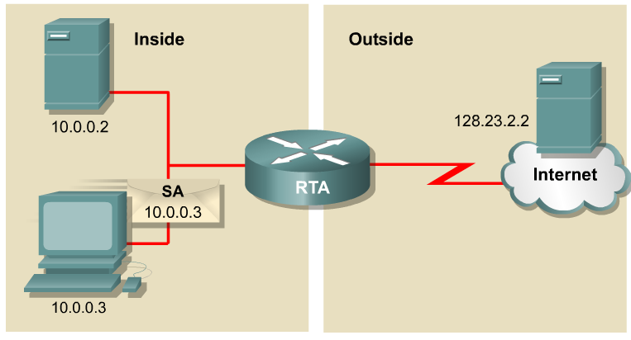
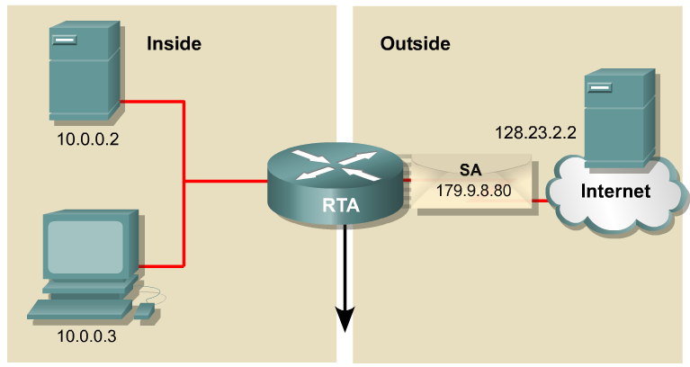
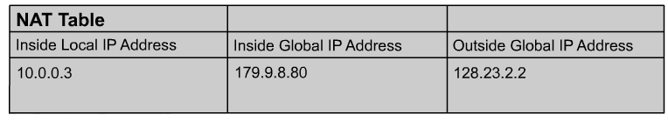
NAT Example
Private
Public
Destination
NAT
Inside Local IP address – The IP private address assigned to a host on the inside network.
Inside Global IP address – A public IP address that represents one or more inside local IP addresses to the outside world.
Outside Global IP address – The public IP address assigned to a destination host on the outside network.

Slide 6
NAT Example – Private source to Public source
1
2
1
2
The translation from Private source IP address to Public source IP address.

Slide 7
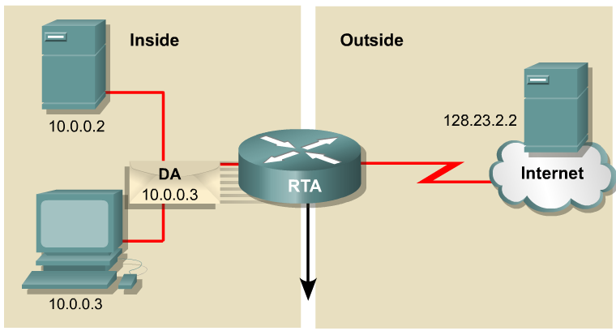
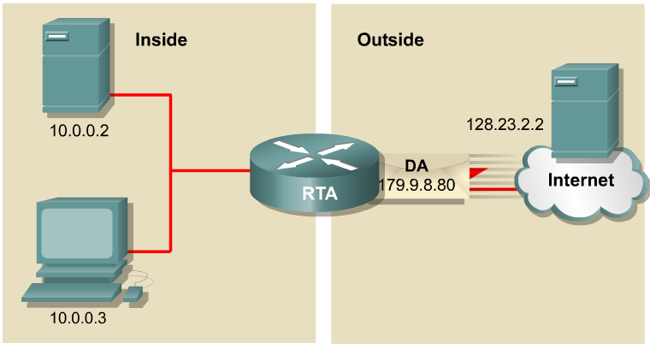
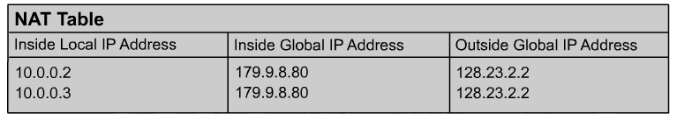
NAT Example - Public destination to Private destination
4
3
.79
4
3
Translation back, from Public destination IP address to Private destination IP address.

Slide 8
NAT - PAT
Port
Address
Translation
8
Notes:
8

Slide 9
NAT - PAT
Maps multiple private IP addresses to a single public IP address
Your ISP assigns one public IP address to your home router
Via PAT several of your friends can simultaneously share the this one public IP address, to surf the internet

Slide 10
NAT - PAT
When a client opens a TCP/IP session, NAT maps a PORT number to client’s source IP address.
When a response comes back from a external server, the source port number becomes the destination port number on the return trip.
This port number determines to which client application, the packet is forwarded.

Slide 11
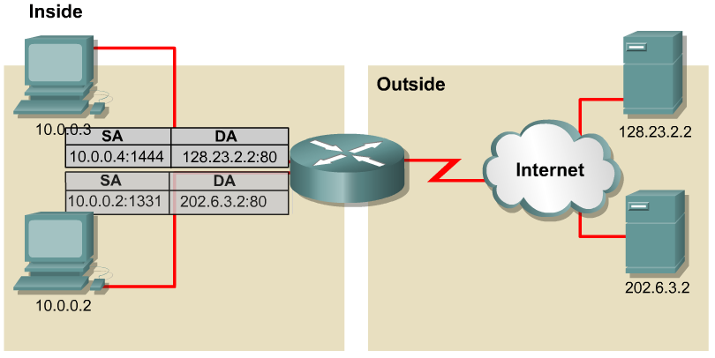
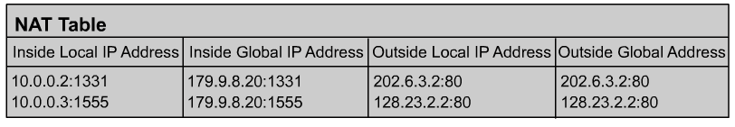
PAT – Port Address Translation
10.0.0.3:1555
NAT
Allows you to use a single Public IP address and assign it to many inside hosts
Multiple private IP addresses can be translated by a single public address (many-to-one translation).
Tracks and translates SA, DA, SP and DP (which uniquely identifies each connection) for each stream of traffic.

Slide 12
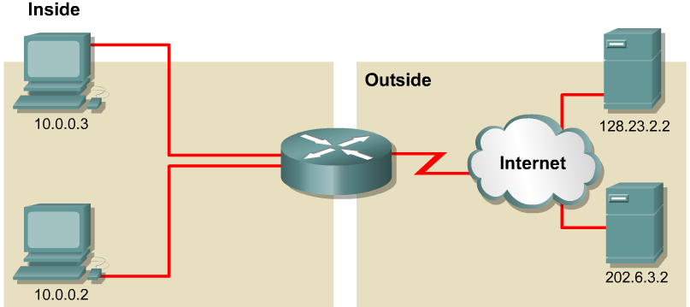
PAT Example – Two PCs using 179.9.8.80
Web Server
PC3
Web Browsing
NAT
PC2
NAT/PAT table maintains translation of:
DA, SA, DP, SP
1331
1
2
1555

Slide 13
PAT Example Two PCs using 179.9.8.80
PC3
PC2
NAT/PAT table maintains translation of:
SA (DA), DA (SA), DP (SP)
PC3
1331
4
3
PC2
1555

Slide 14
NAT - SAT
Static
Address
Translation
14
Notes:
14

Slide 15
Static NAT
Uses a one-to-one mapping of private and public addresses
Mappings remain constant
Useful for web servers or hosts that must have a constant address that is accessible from the internet

Slide 16
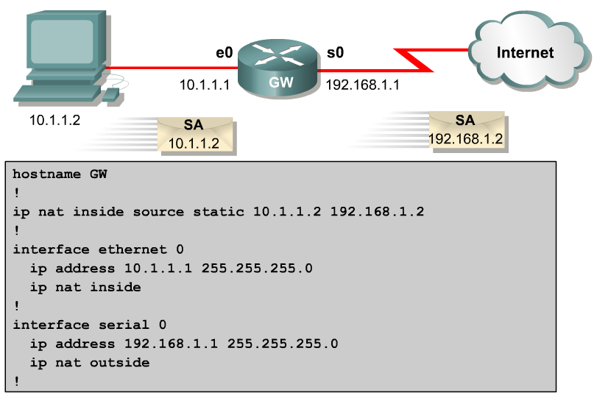
Configuring Static NAT
Inside Fa0/0
S0/0/0 Outside
Fa0/0
S0/0/0

Slide 17
Dynamic NAT
Uses a pool of public addresses and assigns them on a first-come, first-served basis
When a host with a Private IP address requests access to the Internet, an ip address from the pool is allocated
The NAT Pool, the range of ip addresses available
The ACL, that permits access to the NAT pool
The Binding Statement, binding the ACL to the NAT Pool

Slide 18
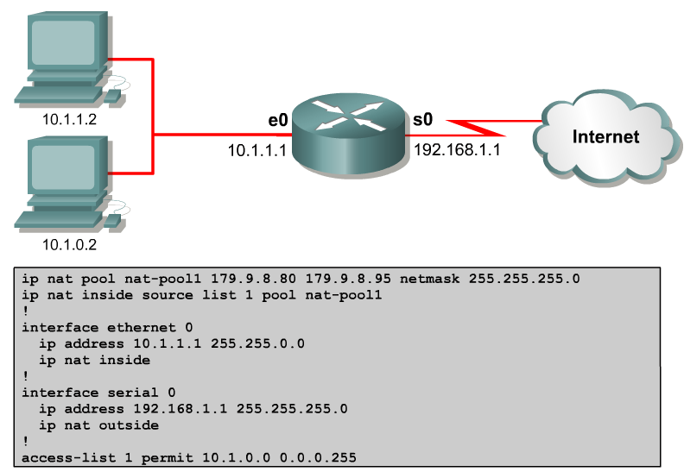
Configuring Dynamic NAT
Inside Fa0/0
S0/0/0 Outside
Translate to this range of outside addresses
Fa0/0
Binding to ACL
S0/0/0
Source subnet IP address must match here
0.0.255.255

Slide 19
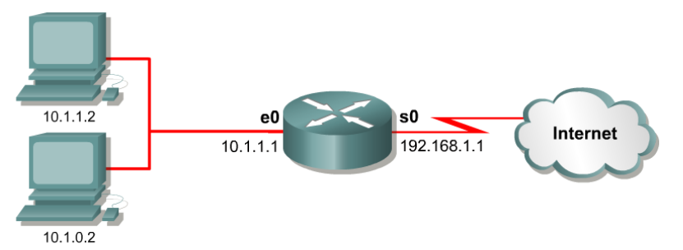
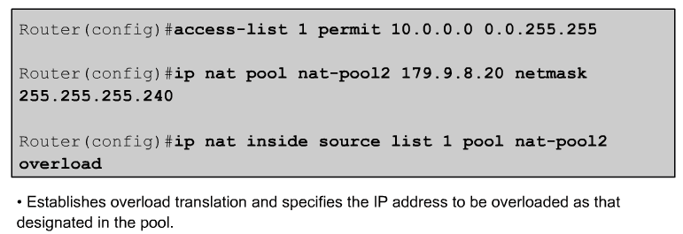
Configuring PAT – Overload on Pool
Inside Fa0/0
S0/0/0 Outside
10.1.0.0 0.0.255.255
ip nat pool nat-pool1 170.9.8.80 179.9.8.95
netmask 255.255.255.0
ip nat inside source list 1 pool nat-pool1 overload
In this example a pool of Public IP addresses is used, using PAT, source ports, to differentiate between connection streams.

Slide 20
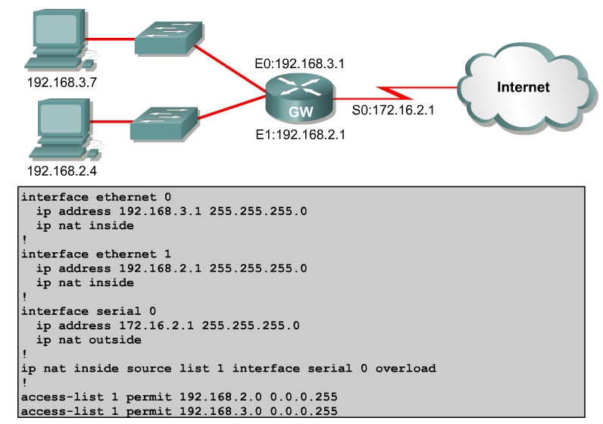
Configuring PAT – Overload on Interface
This is a different example, using the the outside interface S0 instead of specifying a pool of IP addresses

Slide 21
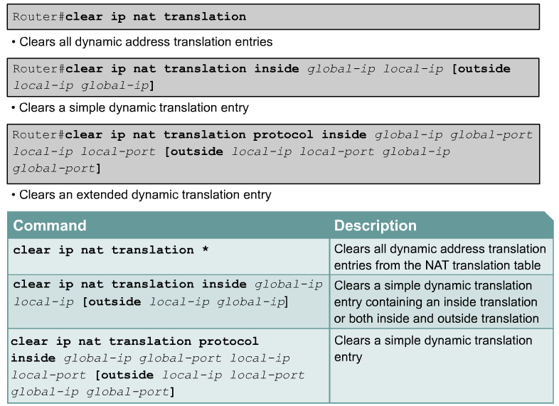
NAT Clear Commands

Slide 22
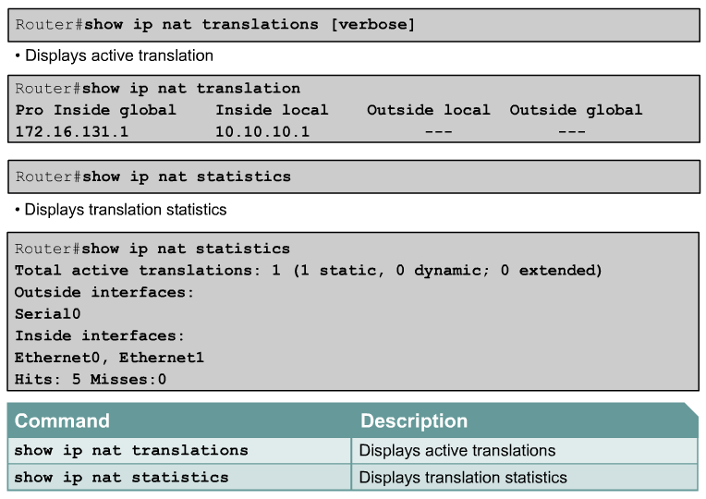
Verifying NAT

Slide 23
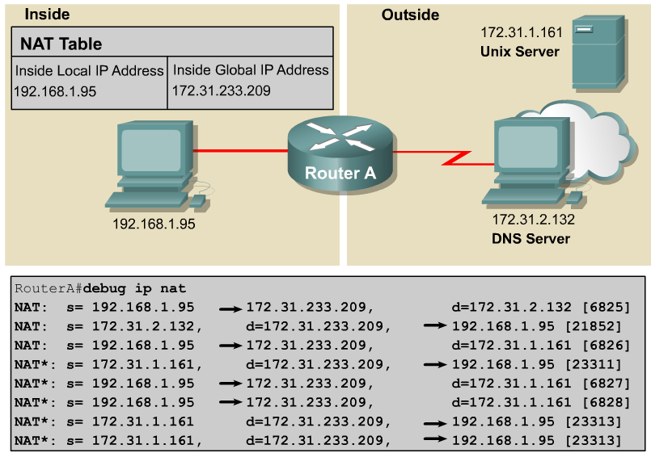
Troubleshooting NAT/PAT
Watch the NAT translations

Slide 24
NAT Explained | Overload, Dynamic & Static - YouTube
THE END

